Slide 1
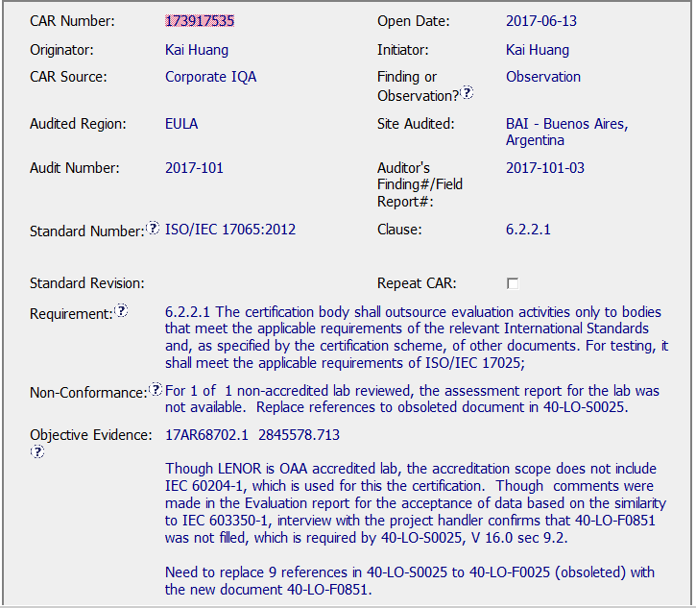
CAR 173917535

Slide 2
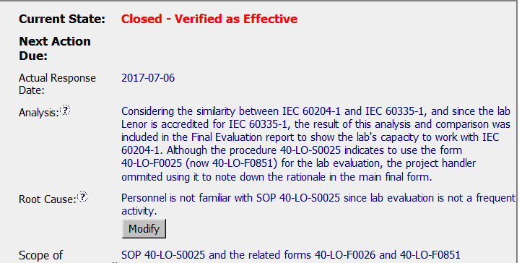
CAR 173917535
8
(Q8) Explain how/If the analysis supports the root cause statement
Analysis does not clearly explains why project handler missed to use the form. However root cause statement mentions it. It is a good practice to mention the names of the stakeholders involved in analysis.

Slide 3
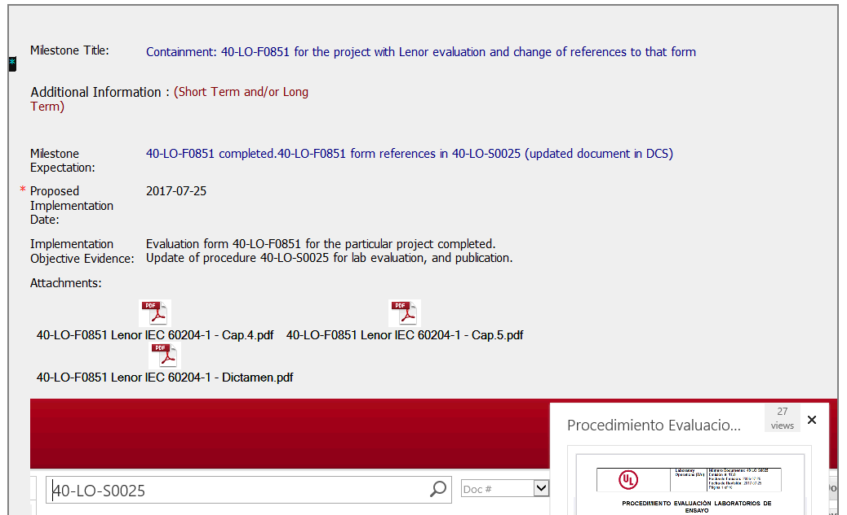
CAR 173917535
9
(Q9) Explain why/If the evidence in the milestones was sufficient to confirm that the nonconformity was eliminated.
Evidences covers most of the milestone expectations. Snap shot/copy of revised 40-LO-S0025 with reference of 40-LO-F0851 form would have given more clarity.

Slide 4
CAR 173917535
Criteria | CAR Review Results
(Q8) Explain how/If the analysis supports the root cause statement | Partially. Analysis does not clearly explains why project handler missed to use the form. However root cause statement mentions it.
(Q9) Explain why/If the evidence in the milestones was sufficient to confirm that the nonconformity was eliminated | Fully. Evidences covers most of the milestone expectations. Snap shot/copy of revised 40-LO-S0025 with reference of 40-LO-F0851 form would have given more clarity.

